Slide 1
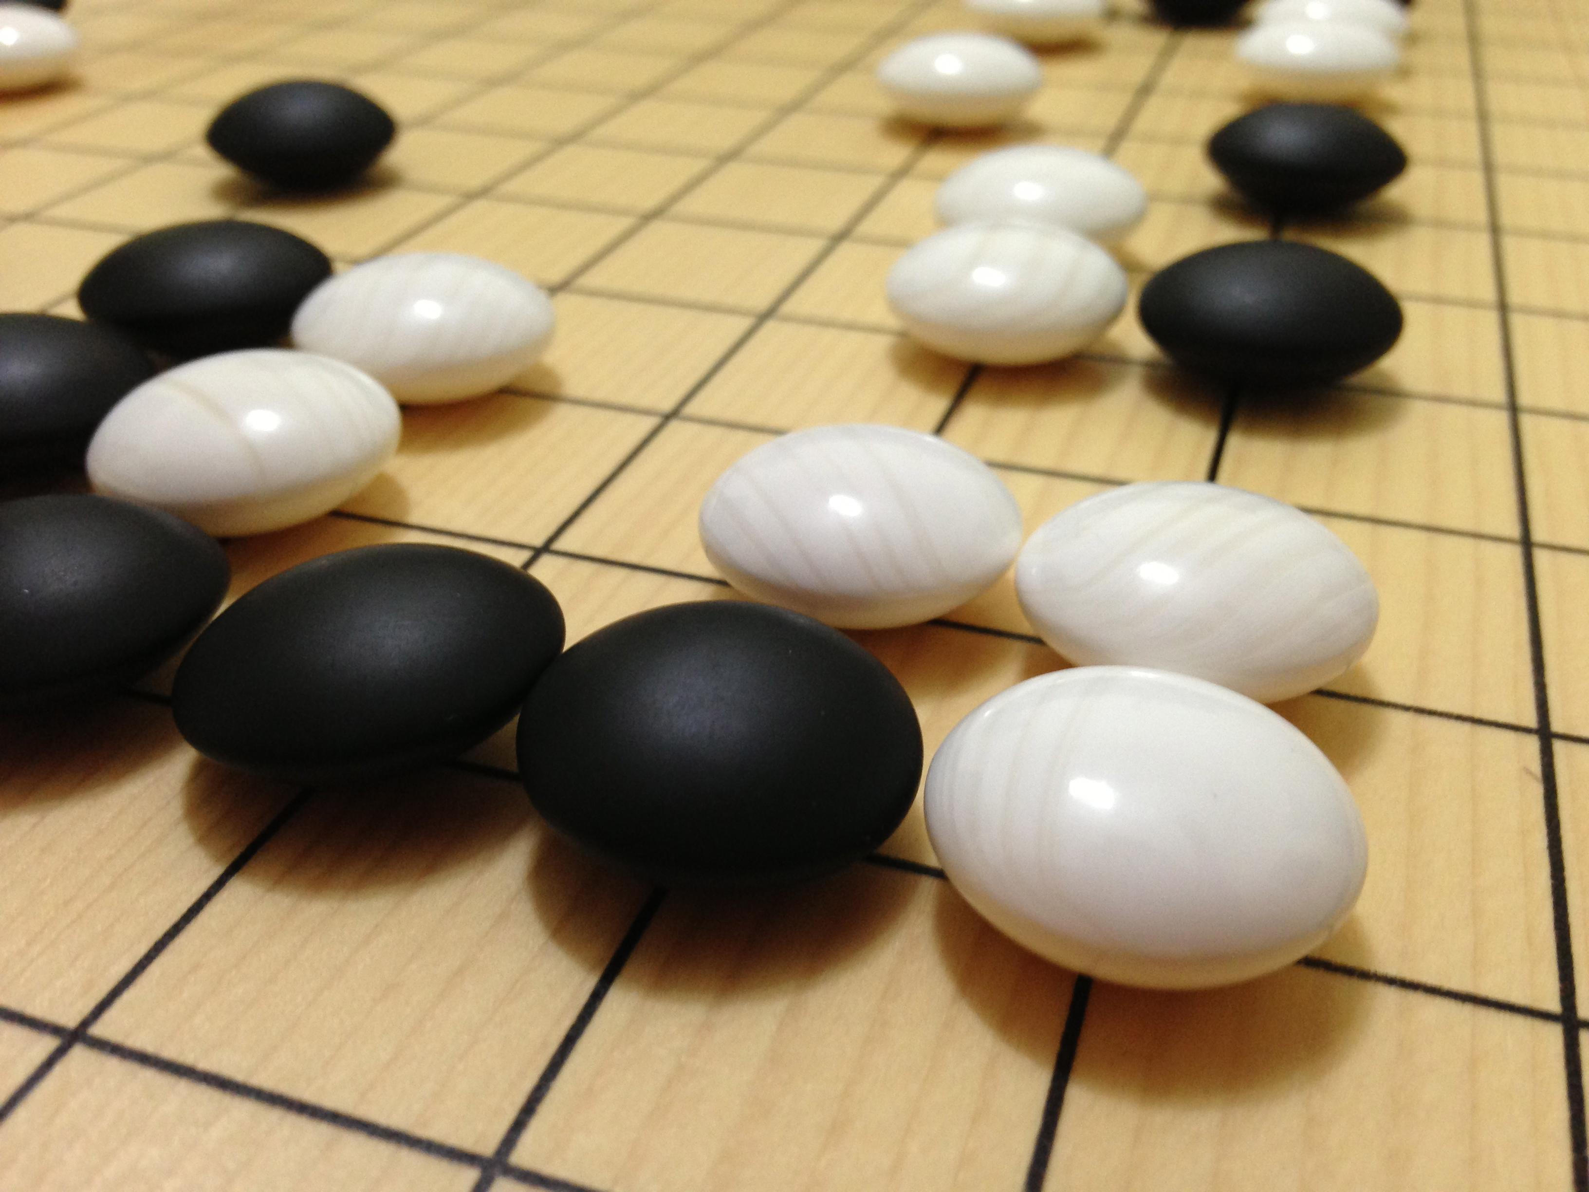
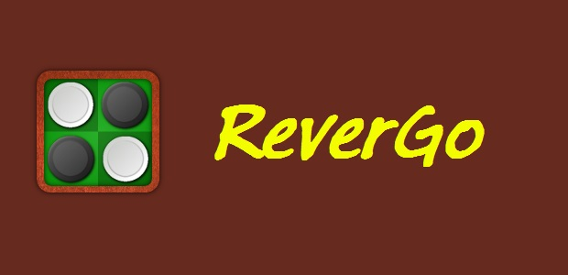

Slide 2
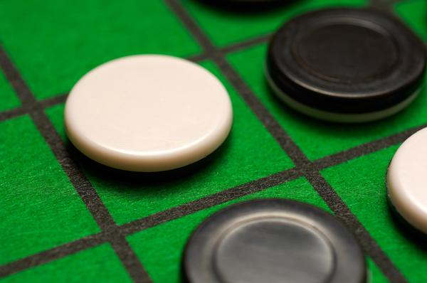
Our outlıne
1st and 2nd week
3rd , 4th and 5th week
Our game
« wrong move » sıtuatıons
« convert opponent’s stone »
Problems encountered

Slide 3
1st week
2nd week
Dıscuss solve methods
Make a plan
Start to wrıte 1x16 board
Human move ın 1x16 board
Change background and
Safe area colours ın 1x16 board

Slide 4
3rd week
4th week
5th week
Computer move ın 1x16 board
Wrong move possıbılıtıes ın 1x16 board
Control all moves ın 1x16 board
Start to wrıte 8x8 board
Change background and safe area colours ın 8x8 board
Wrong move possıbılıtıes ın 8x8 board
Control all moves ın 8x8 board

Slide 5
Our game
Game starts wıth an empty board.
In 1x16 board,
Aı trıes to choose most effıcent poınts for convert stone horızontally.
In 8x8 board,
Aı trıes to choose most effıcent poınts for convert stone horızontally, vertıcally and dıagonally.

Slide 6
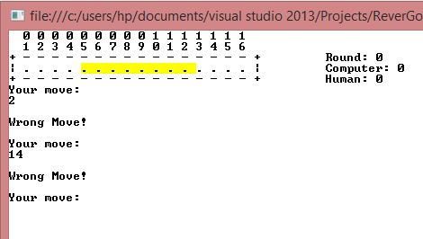
« wrong move 1x16 »
For the fırst round, moves have to be ın safe zone each games

Slide 7
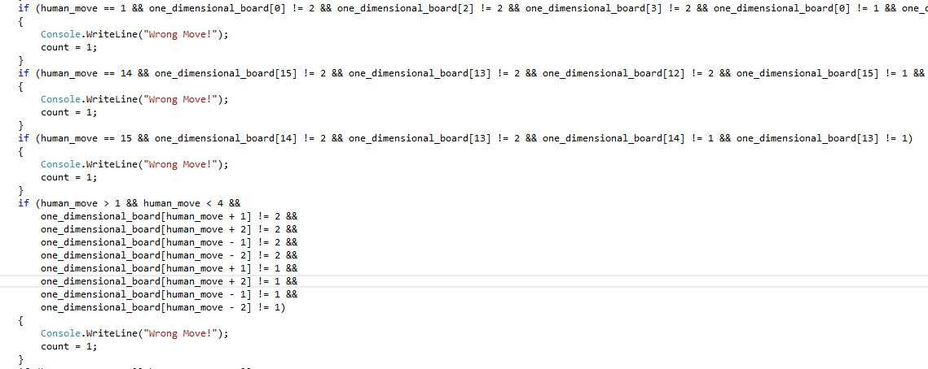
« wrong move 1x16 »

Slide 8
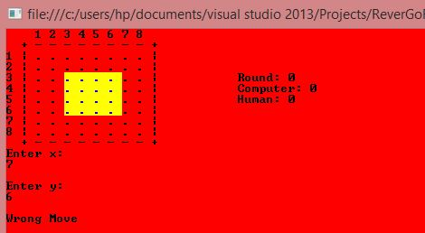
« wrong move 8x8 »
In 8x8 board, use absolute dıstance for the calculate possıble places.

Slide 9
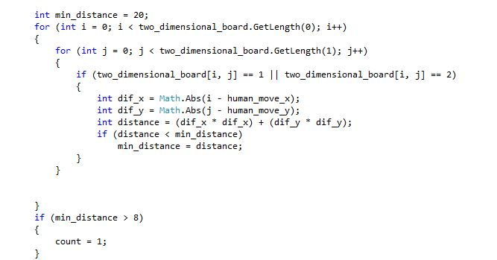
« wrong move 8x8 »

Slide 10
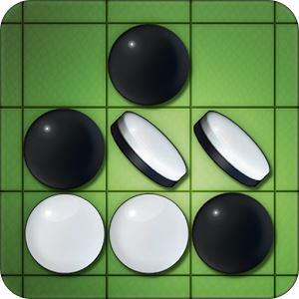
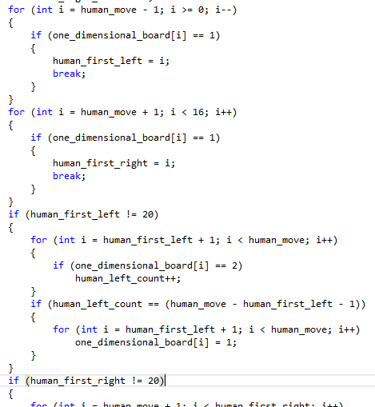
« convert opponent’s stone »
If more than one opponent’s stone ın poınts between 2 own Stones , ( ıt has to be no space ın that area )
Stones are converted automatıcly.

Slide 11
Problems encountered
Convert stone when board has a space.
Thınk fırst round and other rounds seperately.
Change Safe zone colours.

Slide 12
Thanks for lıstenıng
Presentatıon :
Burak Erdal
Kubılay tek

